Slide 1
PROFESSIONAL ETHICS

Slide 2

Introduction
Ethics, sometimes known as moral philosophy, is not easily defined and philosophers provide different explanations of it.
The word 'ethics' is derived from the Greek word ethikos (root form ethos) which means "character" or "custom." For the Greeks, it referred to the appropriate or customary way to behave in society.
The word morality, has its root in the Latin word moralis and is concerned with which actions are right and which are wrong, rather than the character of the person. Today, the two terms are often used interchangeably.

Slide 3
Approaches to Ethics
Normative Ethics
Normative ethics was the prevalent form of ethics in philosophy till the end of the 19th century. It includes a consideration of the importance of human freedom, & a discussion of the limits of a human's responsibility for moral decisions and for the consequences of his actions. The role of conscience in moral decision making is also a part of normative ethics. This is the traditional way of viewing ethics.
Descriptive Ethics
Descriptive ethics is the study of ways in which different people and societies have answered moral questions. Can it be described as moral sociology or moral anthropology, a description of the moral code prevailing in different societies? It involves different approaches inside one society for the resolution of ethical problems.
Metaethics
Metaethics is, sometimes called moral philosophy or philosophical ethics. This group attracts considerable interest today. It seeks to understand the meaning and function of moral language, and of ethical terms such as good and bad. It looks at the logic used in arriving at the conclusion of an argument that justifies a moral choice.

Slide 4
Meaning of Ethics
Ethics involves moral principles which, in turn, involve the way individuals, groups or organisations conduct themselves which of the time as good or bad conduct. It has to do with fulfilling the relationship between people and society at large. When applied in a business context, it becomes business ethics. Ethics in business has become one of the most challenging issues confronting the whole business community. Establishing ethical climate is like starting an endless marathon. It is an "on-going process" and never stops. The stakeholder, the management, the staff and everyone associated should ensure commitment towards ethical behaviour at all levels.
Major Attributes of Ethics
Concept: The field of ethics may be conceived as a discipline, science, study or evaluation.
Content: The subject matter of ethics is concerned with what is good or bad, and right or wrong.
Judgment: It is concerned with the overt act. Behaviour and its causes are judged.
Standards: Judgment is based on standards which are, in turn, based on values.
Values: The set of values and criteria used as standards for judging human conduct.

Slide 5
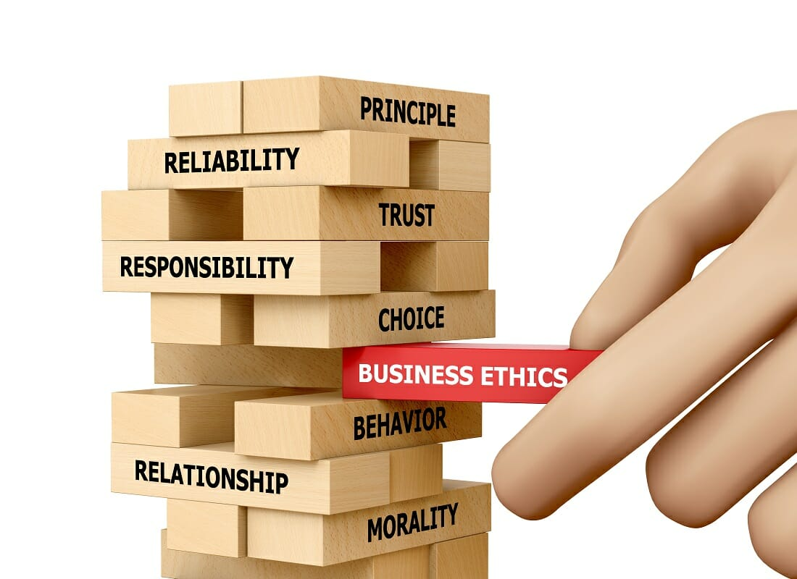
Business Ethics
Business ethics refers to implementing appropriate business policies and practices with regard to arguably controversial subjects. Business ethics is very much influenced by social movements, social system and social preferences. No business can survive or grow without social harmony. Individual's values, however best they may be, are not sufficient to attain the maximum level of ethical performance. It guides executives, managers, and employees in their daily actions and decision-making. Some facets of business ethics are:
Stakeholders/ shareholders or other providers of money.
Employees.
Customer Relations.
Community/ Society.
Government.
Approaches to Business Ethics:
Profit motive approach:
Legal approach:
Moral obligations approach

Slide 6

Importance of Ethics
WHY ETHICS?
Basic human needs: Being fair, honest and ethical is one the basic human needs. Most people want to be ethical in both- private as well as professional lives.
Credibility among the public: An organization that is believed to be driven by moral values is respected in the society even by those who may have no information about the working and the businesses or an organization. A company perceived by the public to be ethically and socially concerned will be honoured and respected more as compared to others. For example: Infosys.
Credibility with the employees: Ethics provide a basis for aligning a company’s leader and its sub-ordinates behaviour to accomplish one common goal/ objective. It creates harmony among employees.
Better decision making: Decisions are driven by values. Ethical decisions made by the company will always be in the interest of the shareholders, other stakeholders and its employees.

Slide 7
Ethics in management refers to a company’s social responsiveness.
Ethical decisions have a significant implication on the organization’s stakeholders, its employees & the shareholders.
The ethical approach includes concerns like justice, individual rights, & utilitarianism.
Managerial ethics improves society at large with:
-Organisational revolution, corporate revolution, managerial revolution, property revolution.
Business ethics is more concerned with its social responsibilities.
Ethics in Management

Slide 8
Organizational Ethics
Change is a necessary way of life for all organizations. The way an organization should respond to external environment refers to organization ethics. No organization should depend on unfair means to earn money. Employees should not indulge in destruction or manipulation of information to get results.
Organizational
Ethics
Common unethical practices prevailing in an organization:
1) The consumers
Adulteration, spurious products, duplicates, injurious products, deceptive advertisements.
2) The Employees
Low salaries, working conditions, exploitation, Unreal acceptance of remuneration.
3) The Government
Tax evasion, pollution, bribes for political support.

Slide 9
Mass Communication & Ethics
Television networks usually try to exercise professional judgment and to avoid offending viewers. Some television networks have published codes of conduct to guide their efforts. In cases where a television station does offend a viewer or group of viewers, laws are in place to guide both the offended party and the television industry. Laws take over when ethics questions are not resolved between people representing two sides of an issue. When a program or an advertisement offends a television viewer, several outcomes might occur. The following is a list of some of the ways in which viewers have, in the past, used their right to object to television programming or advertising, and registered their concerns about the ethics of television.
A viewer might write a letter of complaint.
A viewer might bring a legal suit against the television network, OR
A specific department or individual employed by the network.
A viewer contacts a consumer group and registers a concern.

Slide 10
Ethical aspects in marketing
Marketing ethics involve moral principles and values that should be followed during marketing communication. They are the guidelines that let companies decide about their new marketing strategies. But also keep in mind that it depends on one’s judgment of ‘right’ and ‘wrong.’ In other words, if a company makes any claims about its products and cannot live up to those claims, it may be called unethical behavior. The American Marketing Association’s code has outlined the responsibilities as:
Responsibility of the marketer.
Honesty & fairness.
Rights & duties in marketing exchange process.
Organizational relationships.
Standards For Ethical Marketing Code
To help identify acceptable practices.
Foster internal control.
Avoid confusion.
Facilitate a basis for discussion.

Slide 11
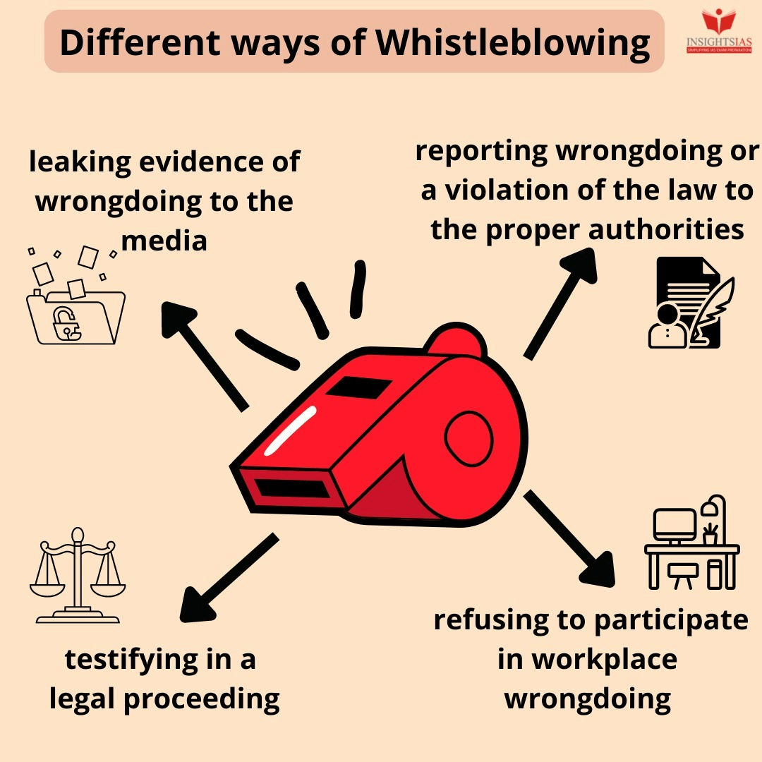
Whistle blowing
'Whistleblowing' is the term used to define an individual's decision to disclose the information regarding unethical, immoral or illegal actions to an authority. Example: Padding an expense report, violating laws on hiring and firing, etc.
Merits (advantages):
Combat fraud
Avoid reputational damage
Prevent issues escalating
Minimise losses
Raise awareness
Create an open culture
Whistle blowing is an anti-corruption tool
It ensures effective system of internal control
It is a good corporate governance practice
Demerits (disadvantages):
Stress, termination and mistrust
Disrupt the team spirit
Mobbing

Slide 12
Education- Ethics & New Professional
On-the job training
Training programmes on the ethical use of the World Wide Web
Employee discussion groups on ethical Issues
Personnel services
Ethical Investing
Ethical investing means allocating financial resources taking into consideration both economic and social criteria, with the goals of maximising the potential financial and social returns to both investor and the investee.

Slide 13
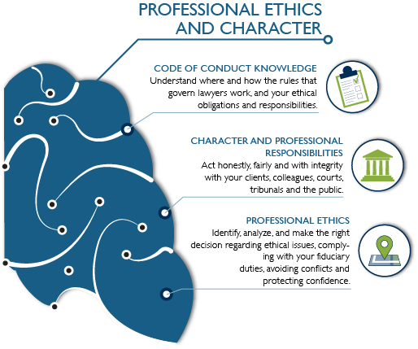
Professional Ethics
Professional ethics encompass the personal and corporate standards of behaviour expected of professionals.
Professional ethics are principles that govern the behaviour of a person or group in a business environment. Like values, professional ethics provide rules on how a person should act towards other people and institutions in such an environment.

Slide 14
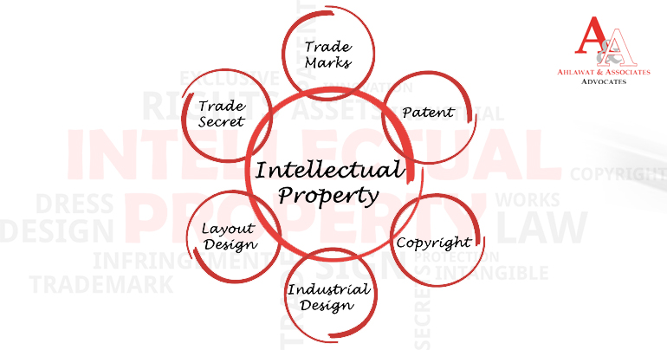
Intellectual Properties & Ethics
World Intellectual Property Organization (WIPO) was created to promote and protect intellectual property (IP) across the world by cooperating with countries as well as international organizations.
WIPO's activities include hosting forums to discuss and shape international IP rules and policies, providing global services that register and protect IP in different countries, resolving transboundary IP disputes, helping connect IP systems through uniform standards and infrastructure, and serving as a general reference database on all IP matters; this includes providing reports and statistics on the state of IP protection or innovation both globally and in specific countries.

Slide 15
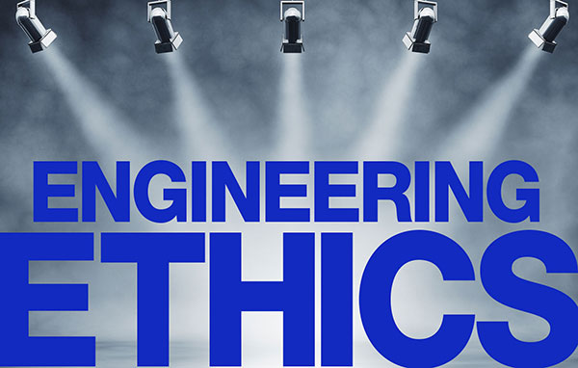
Fundamental Principles
-Hold paramount the safety, health, & welfare of the publicly;
-Perform services only in areas of their competence;
-Issue public statements only in an objective and truthful manner;
-Act for each employer or client as faithful agents or trustees· '
-Avoid deceptive acts and
-Conduct themselves honourably, responsibly, ethically, and lawfully so as to enhance the honour, reputation, and usefulness of the profession.

Slide 16
Thank you

